Slide 1
CS112: Introduction to Python programming
Week 3:Flow control

Slide 2
Contents
Flow control：IF
Flow control：For

Slide 3
The input() function
The input() function is used to gather data from the user:
variable_name = input([prompt])
The prompt statement gives an indication to the user of the value that needs to be entered through the keyboard.
The information obtained from screen via input function is always a str type

Slide 4
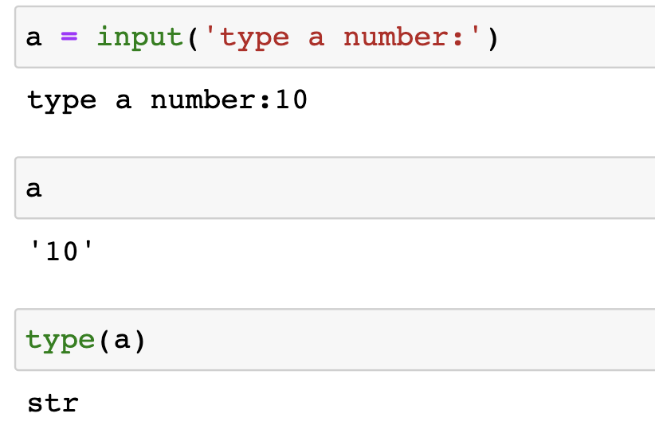
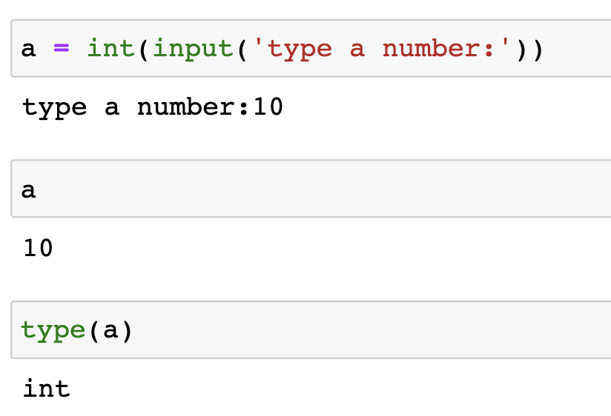
The input() function

Slide 5
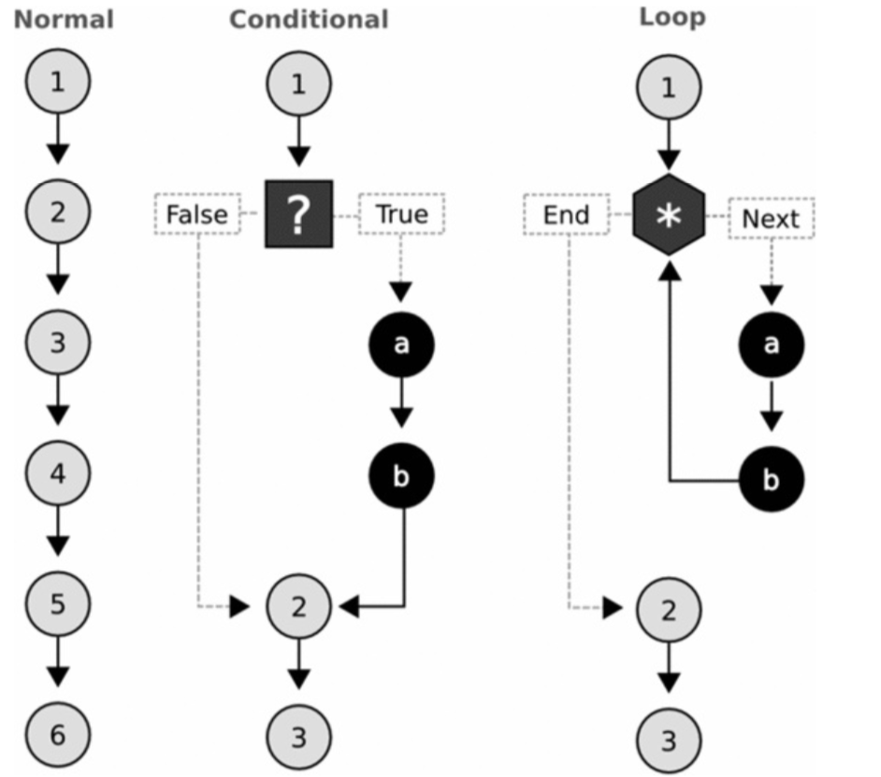
Flow control （流程控制）
Normal flow: A program proceeds from one line to the next;
Conditional (条件): using an “if ”statement means a block of code is only executed if the test evaluates to be logically true, and otherwise the block is skipped.
Loop（循环）: starting with a ‘for ’or ‘while ’statement, causes a block of code to be repeated a number of times.

Slide 6
Conditional statement: if
The simplest conditional control is a simple if statement.
If evaluates an expression. If the expression is true, the block of code just after the if clause is executed.
A basic schema of an if condition:
if EXPRESSION:
BLOCK1
EXPRESSION must be an expression that returns True or False.
The if decision control flow statement starts with if keyword and ends with a colon

Slide 7
Conditional statement: if
number = int(input("Enter a number: "))
if number > 0:
print(f"The number is a positive number")
results=59
if results>=60:
print ('及格')
else :
print ('不及格')
num = 6
if num :
print('Hello Python')

Slide 8
Conditional statement: if
number = int(input("Enter a number: "))
if number > 0:
print(f"The number is a positive number")
results=59
if results>=60:
print ('及格')
else :
print ('不及格')
num = 6
if num :
print('Hello Python')

Slide 9
Conditional statement: if
The simplest conditional control is a simple if statement.
If evaluates an expression. If the expression is true, the block of code just after the if clause is executed.
A basic schema of an if condition:
if EXPRESSION:
BLOCK1
EXPRESSION must be an expression that returns True or False.
Logical operators
<, <=
>, >=
==
!=
and, or, not

Slide 10
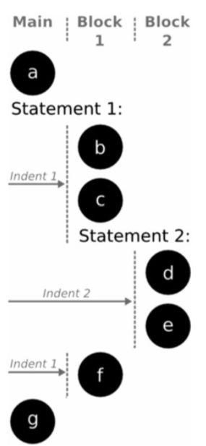
Conditional statement: if
Indentation（缩进）
Python indentation is a way of telling a Python interpreter that the group of statements belongs to a particular block of code
Whitespace (usually 4) is used for indentation in Python. All statements with the same distance to the right belong to the same block of code.
PEP 8:
Use 4 consec​utive spaces to indicate indent​ation Prefer spaces over tabs.

Slide 11
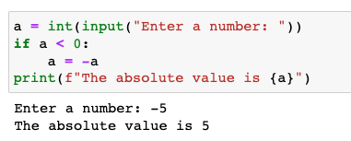
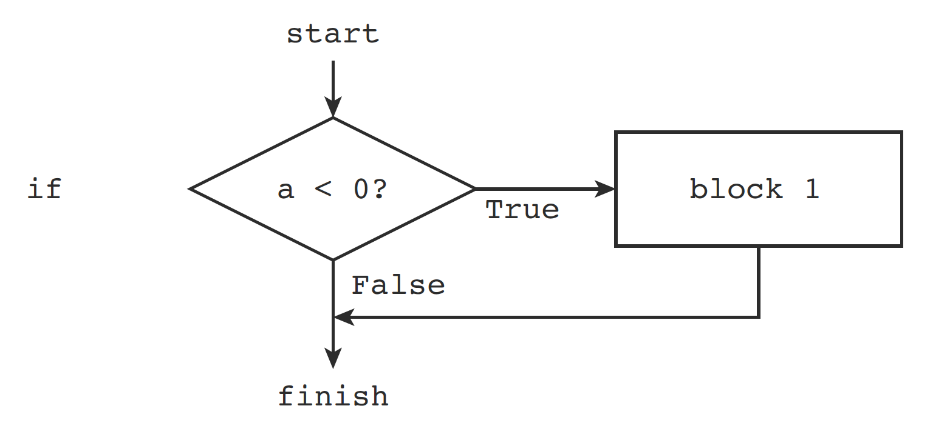
Conditional statement: if
The program below, which demonstrates how to take the absolute value of an integer number:

Slide 12
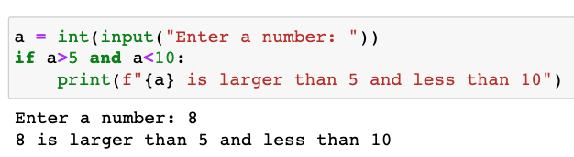
Conditional statement: if
Multiple conditions in one if
The expression is evaluated from left to right.

Slide 13
Conditional statement: if-else
If evaluates an expression. If the expression is true, the block of code just after the if clause is executed. Otherwise, the block under else is executed.
The else statement does not have any condition
The if…else statement allows for a two-way decision
A basic schema of an if-else condition:
if EXPRESSION:
BLOCK1
else:
BLOCK2
if and else keywords should be aligned at the same column position

Slide 14
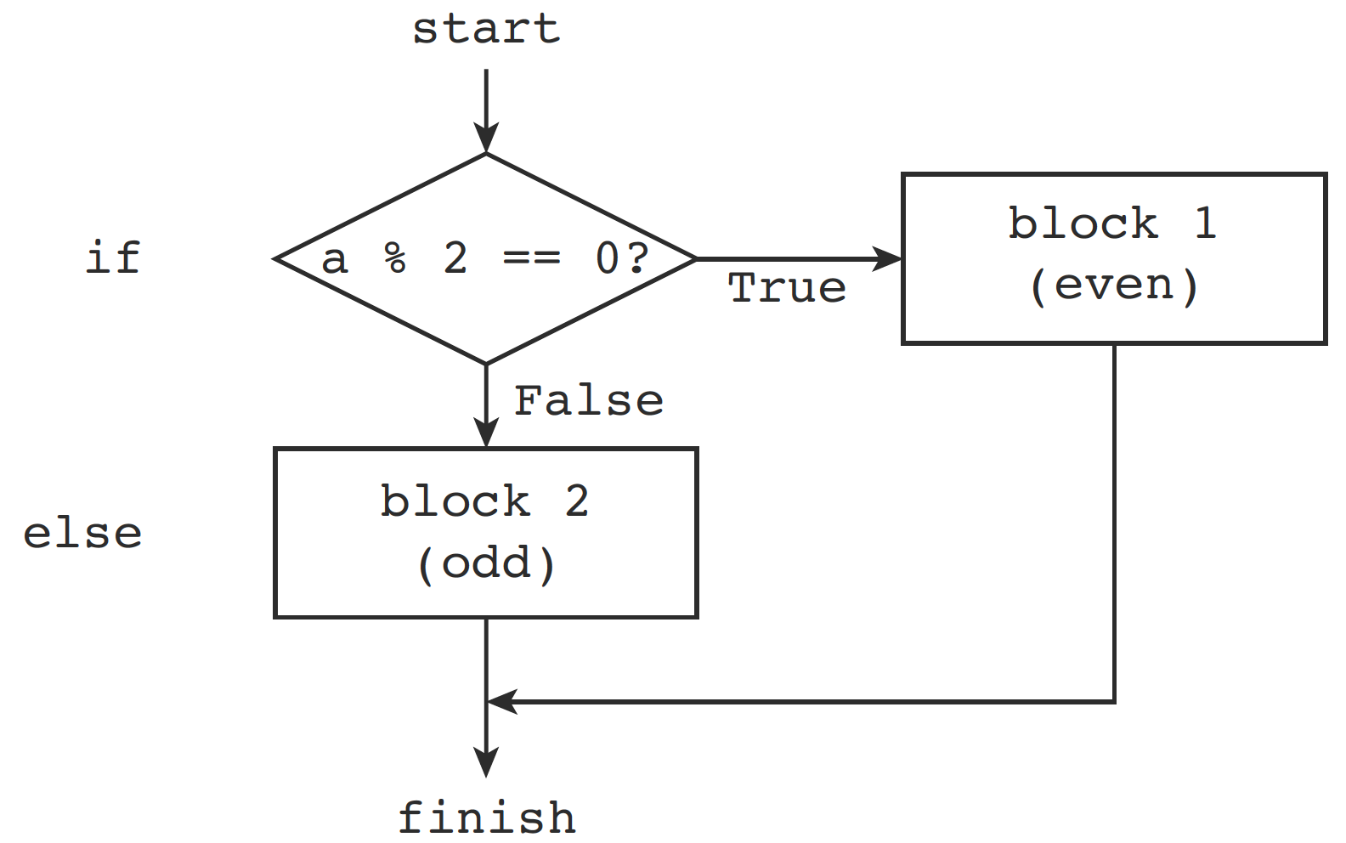
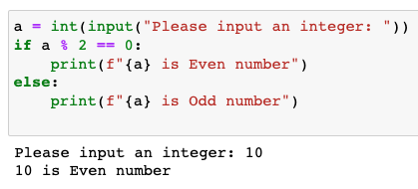
Conditional statement: if-else
The following program testing whether an integer is even or odd provides a simple if…else statement example

Slide 15
Conditional statement: if-elif-else
The if-elif-else is a multi-way decision control statement.
There can be only one else block in the end.
There can be zero or more elif parts each followed by an indented block
if EXPRESSION1:
BLOCK1
elif EXPRESSION2:
BLOCK2
:
:
else:
BLOCKN
Only the preceding Boolean expressions evaluated to False, the current statement will be evaluated
Only the Boolean expression evaluated to True, the statement block will be executed
Notes:
primer = 'ATCGACAGAGC'
seqsize = len(primer)
if seqsize < 10:
print('The primer must have at least ten nucleotides')
elif seqsize < 25:
print('This size is OK')
else:
print('The primer is too long')

Slide 16
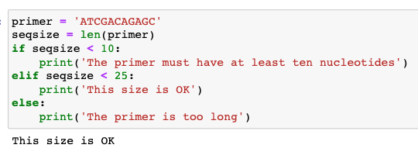
Conditional statement: if-elif-else
if EXPRESSION1:
BLOCK1
elif EXPRESSION2:
BLOCK2
elif EXPRESSION3:
BLOCK3
else:
BLOCK4
背景知识：设计一段用于PCR测试的引物，其序列长度要介于10-25个碱基之间
Notes:
primer = 'ATCGACAGAGC'
seqsize = len(primer)
if seqsize < 10:
print('The primer must have at least ten nucleotides')
elif seqsize < 25:
print('This size is OK')
else:
print('The primer is too long')

Slide 17
Conditional statement: Nested conditionals
An if statement that contains another if statement either in its if block or else block is called a nested if statement
if EXPRESSION1:
if EXPRESSION2:
BLOCK1
else:
BLOCK2
elif EXPRESSION3:
BLOCK3
…
else:
BLOCK4
Notes:
primer = ''
seqsize = len(primer)
if seqsize < 10:
if seqsize == 0:
print('You must enter something!')
else:
print('The primer must have at least ten nucleotides')
elif seqsize < 25:
print('This size is OK')
else:
print('The primer is too long')

Slide 18
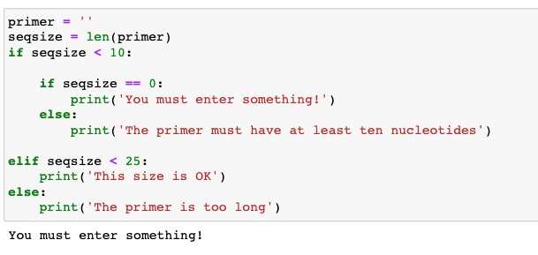
Conditional statement: Nested conditionals
An if statement that contains another if statement either in its if block or else block is called a nested if statement
if EXPRESSION1:
if EXPRESSION2:
BLOCK1
else:
BLOCK2
elif EXPRESSION3:
BLOCK3
…
else:
BLOCK4
Notes:
primer = ''
seqsize = len(primer)
if seqsize < 10:
if seqsize == 0:
print('You must enter something!')
else:
print('The primer must have at least ten nucleotides')
elif seqsize < 25:
print('This size is OK')
else:
print('The primer is too long')

Slide 19
Conditional statement: Nested conditionals

Slide 20
Loops (循环)
A loop is a statement or a block of statements that is executed repeatedly.
Python has two kinds of loops
for loops
while loops
Notes:
primer = ''
seqsize = len(primer)
if seqsize < 10:
if seqsize == 0:
print('You must enter something!')
else:
print('The primer must have at least ten nucleotides')
elif seqsize < 25:
print('This size is OK')
else:
print('The primer is too long')

Slide 21
FOR loop
This control structure allows code to be repeatedly executed while keeping a variable with the value of an iterable object.
for VAR in ITERABLE:
BLOCK
iterable objects （可迭代对象）:
e.g. lists, tuples, strings, and dictionaries. Files and custom-made objects can also be iterable.
The for loop starts with the for keyword and ends with a colon(:)
This structure results in the repetition of BLOCK as many times as elements are in the iterable object. On each iteration, VAR takes the value of the current element in ITERABLE.

Slide 22
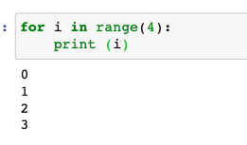
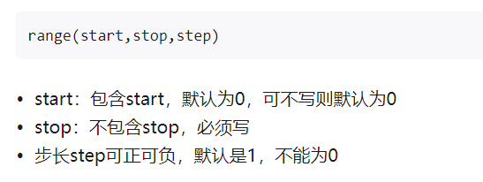
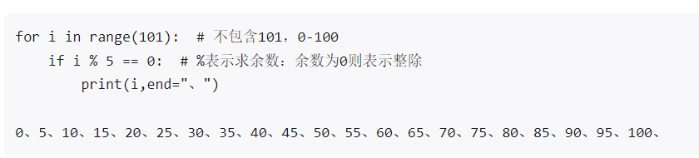
FOR loop
range( )：python内置函数
求100以内被5整除的数字
range(10)
range(0,10)
range(0,10,2)

Slide 23
The for loop
打印100以内所有的奇数并求和
s = 0
for i in range(1, 100, 2):
print(i, end=' ')
s = s+i
print(f'\n{s}')
1 3 5 7 9 11 13 15 17 19 21 23 25 27 29 31 33 35 37 39 41 43 45 47 49 51 53 55 57 59 61 63 65 67 69 71 73 75 77 79 81 83 85 87 89 91 93 95 97 99
2500

Slide 24
FOR loop
Positional indices
bases=”ABCDEF”
for i in range(6):
print(bases[i])
如果要倒序打印呢?
base="abcdefg"
for i in range(len(base)-1,-1,-1):
print(base[i] , end=" ")
#base[::-1]
Notes:
bases = ['A','T','C','G']
for i in range(4):
print(bases[i])

Slide 25
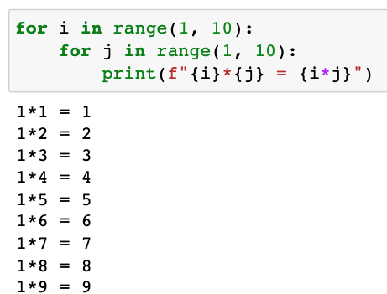
FOR loop
Nested loops: loops within loops
…
…

Slide 26
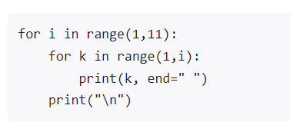
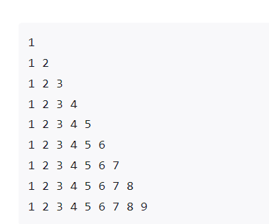
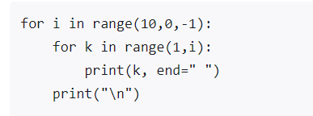
FOR loop
Nested loops: loops within loops
如果要打印下列矩阵
如果要倒过来打印呢？
…
…

Slide 27
FOR loop
九九乘法表的制作
for i in range(1,10):
for j in range(1,i+1): # 为了保证有4*4，也就是同个数字相乘的等式，需要让i出现，使用i+1
print('{}x{}={}'.format(j, i, i*j), end=" ") # end的结束符号用空格
print("\n")

Slide 28
练习
输出0～100能被3和7整除的所有数
for i in range(101):
if i % 3 == 0 and i % 7 == 0:
print(i)

Slide 29
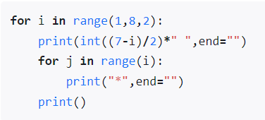
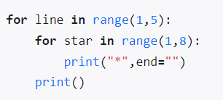
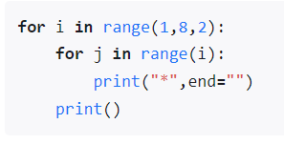
练习
请打印下列图形
图1
********
********
********
********
********
图2
*
***
*****
*******
图3
*
***
*****
*******

Slide 30
WHILE loop
The while loop starts with the while keyword and ends with a colon.
The Boolean expression is evaluated before the statements in the while loop block is executed
After each iteration of the loop block, the Boolean expression is again checked, and if it is True, the loop is iterated again
This process continues until the Boolean expression evaluates to False and at this point the while statement exits:
while EXPRESSION :
BLOCK

Slide 31
WHILE loop
The while loop starts with the while keyword and ends with a colon.
It is very important to take into account that there should be an instruction inside the block to make the while condition false.
Otherwise, we could enter into an infinite loop.
while EXPRESSION :
BLOCK

Slide 32
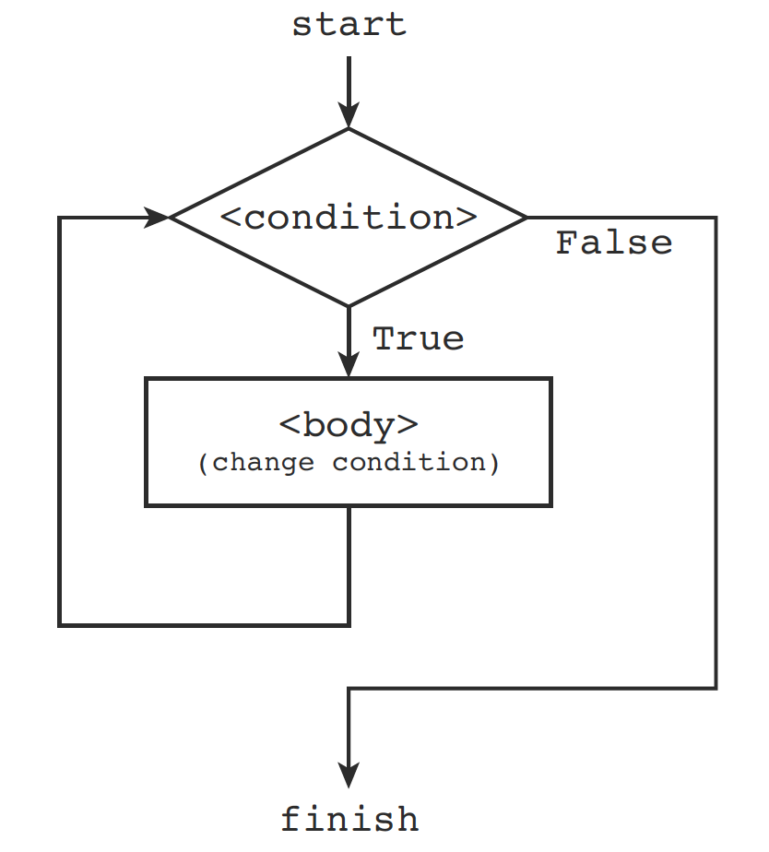
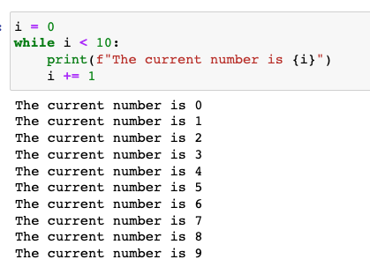
WHILE loop
Write a program to display first 10 numbers using while loop starting from 0:

Slide 33
While loop
一张纸的厚度是0.08毫米。对折几次可以超过珠峰的高度？(珠峰高度是8848.13米)
zhufeng=8848130
height=0.08
count=0
while height<=zhufeng:
height*=2
count+=1
print(“需要对折：”,count,“次”)

Slide 34
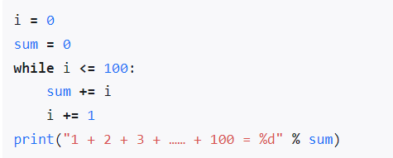
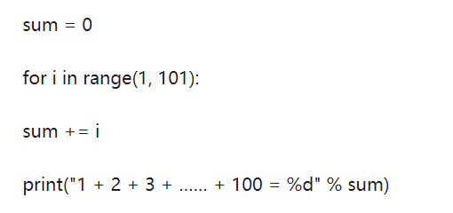
While过程
求1到100的合计？

Slide 35
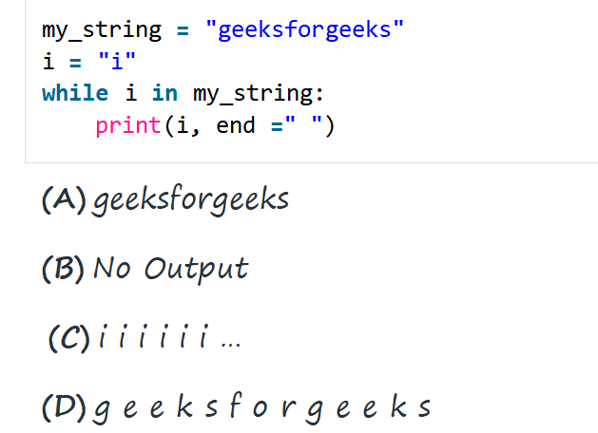
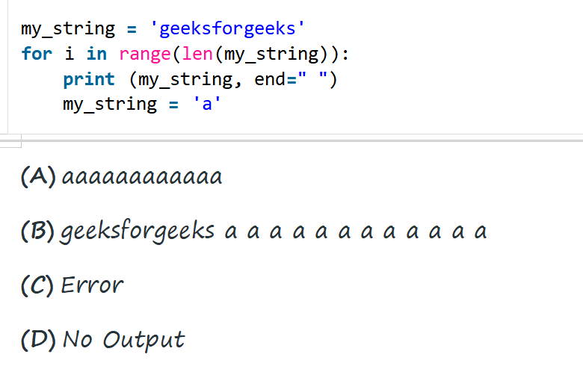
练习

Slide 36
While 和 For的区别
while循环与for循环都属于循环结构，两者均可重复执行一段代码，但两者使用的场合不同。
while循环与for循环的使用场景比较：
√ while循环结构更适合于不知道该循环会被执行多少次时，希望在满足某种条件的情况下循环结束的场景。
√ for循环结构更适合于有明确的循环次数（或循环范围）的场景。
while循环与for循环的共同点：
√ 两者都是重复执行一段程序代码。
√ 两者都是在满足一定循环条件时执行，不满足循环条件则退出循环结构，执行后面的循环语句。

Slide 37
Loop control statements
Loop control statements change loop execution from its normal sequence, providing greater control over the execution of code in a loop. The break and continue statements.
Python supports the following control statements.
Break statement
Continue statement
Pass statement

Slide 38
The Break statement
The break statement is used to terminate the loop or statement in which it is present. After that, the control will pass to the statements that are present after the break statement, if available.
If the break statement is present in the nested loop, then it terminates only those loops which contains break statement.

Slide 39
The Continue statement
The continue statement is opposite to that of break statement, instead of terminating the loop, it forces to execute the next iteration of the loop.
When the continue statement is executed in the loop, the code inside the loop following the continue statement will be skipped and the next iteration of the loop will begin.

Slide 40
The Continue statement
The continue statement is opposite to that of break statement, instead of terminating the loop, it forces to execute the next iteration of the loop.
When the continue statement is executed in the loop, the code inside the loop following the continue statement will be skipped and the next iteration of the loop will begin.
break jump out of the loop while continue skip the current iteration

Slide 41
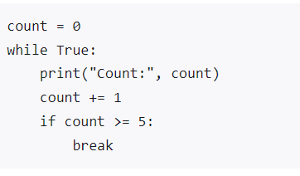
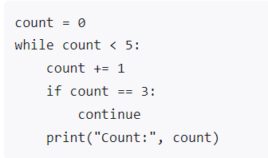
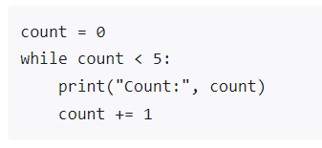
example break and continue

Slide 42
Examples of the continue and break statements:
n = 10
while n > 0:
n -= 1
if n == 5:
continue
print(f"The current value is {n}")
The current value is 9
The current value is 8
The current value is 7
The current value is 6
The current value is 4
The current value is 3
The current value is 2
The current value is 1
The current value is 0
n = 10
while n > 0:
n -= 1
if n == 5:
break
print(f"The current value is {n}")
The current value is 9
The current value is 8
The current value is 7
The current value is 6
break jump out of the loop, while continue skip the current iteration

Slide 43
example break
Print integer numbers using while loop, and stop when the number reaches 8:
stop = 8
n = 0
while True:
print(f"The current number is {n}")
n += 1
if n > stop:
break

Slide 44
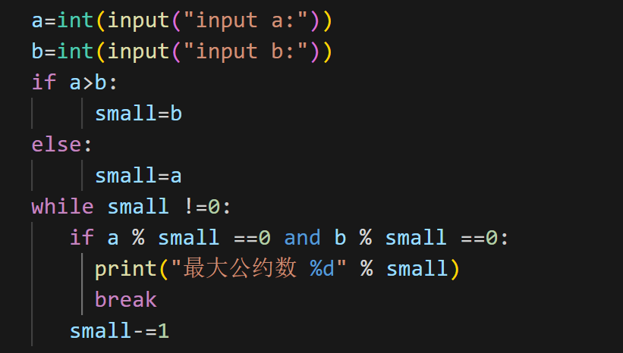
example break
求2个数的最大公约数(公约数是小于等于2个数中的数值小的那个，且能被2个数整除)

